Slide 1



SAVING THE ECONOMY FROM RUIN
(with a hyperscale PaaS)
Ben Conrad & Matt Hyatt
Notes:
BEN
Hello. I’m Ben Conrad. I joined the Civil Service 4 years ago in order to come and work on the Digital Platform that we’re going to be talking about. I’ve had a few job titles in that time and currently the line at the bottom of my emails reads “Head of Agile Delivery”.
MATT:
Hi, I’m Matt. I’m an Agile Delivery Consultant with Equal Experts. I’ve spent the last 2 years working together with Ben and a team of about 70 people who build and maintain HMRC’s primary digital platform. Today we’re going to talk about that platform, why we think it’s successful and then share some stories about delivering services in the midst of the pandemic

Slide 2



SAVING THE ECONOMY FROM RUIN
(with a hyperscale PaaS)
Ben Conrad & Matt Hyatt
Notes:
BEN
Hello. I’m Ben Conrad. I joined the Civil Service 4 years ago in order to come and work on the Digital Platform that we’re going to be talking about. I’ve had a few job titles in that time and currently the line at the bottom of my emails reads “Head of Agile Delivery”.
MATT:
Hi, I’m Matt. I’m an Agile Delivery Consultant with Equal Experts. I’ve spent the last 2 years working together with Ben and a team of about 70 people who build and maintain HMRC’s primary digital platform. Today we’re going to talk about that platform, why we think it’s successful and then share some stories about delivering services in the midst of the pandemic

Slide 3
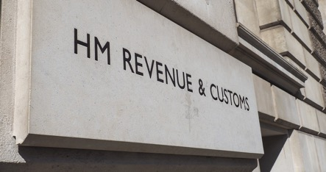


CONTEXT
WHAT IS HMRC
Notes:
BEN Some context: what is HMRC?
We are the UK’s tax collector. We collect taxes from individuals and businesses in the United Kingdom, and as you may have heard there’s a slightly expanded role in the area of Customs due to some rule changes recently.
We are an operational department, rather than setting policy. As with the rest of the Civil Service, we are apolitical. HM Treasury, headed by the Chancellor of the Exchequer, sets the economic policy for the UK Government, whereas HM Revenue and Customs is not headed by a Government Minister at all. HMRC does need to make the policies of the government a reality, which can be quite challenging in itself.
We’re also THE big player in the UK Government when it comes to Digital.
HMRC is responsible for more than ~70% of all government interactions with the public that happen over the internet. We operate more transactional Digital Services than the rest of government put together.

Slide 4





THE PANDEMIC STRIKES
Notes:
BEN
And it’s because of that, that when Covid-19 hit, HMRC played a key role in delivering the UK Government’s financial response to the economic crisis.
On 23rd March 2020 the Prime Minister made an announcement in which he gave “the British people a very simple instruction - you must stay at home.”
In the first lockdown the British people were only allowed to leave their homes to go shopping for necessities, take exercise, or if absolutely necessary, to travel to work. Or check their ability to drive by visiting Barnard Castle, obviously.
Everyone working on building Digital Services were of course able to work from home - indeed we had been doing so for some time prior to this instruction. We have the technology and there was no negative impact to our productivity. Lucky as we were, we all knew people who were not able to work at all.
And of course this had a whopping great impact on the UK economy...

Slide 5
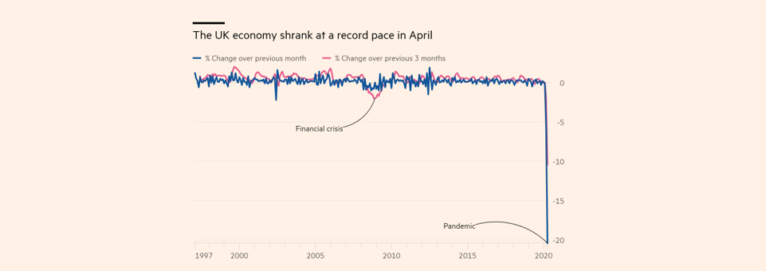
THE ECONOMIC HIT
Notes:
BEN
Every country had its own experience of the pandemic. For the UK, like many European countries, it was extreme.
We experienced the most severe economic contraction for over 300 years. It made the the global financial crisis look like a blip.
This chart shows the impact of the first national lockdown, but there have been three so far, during which
We were ordered to stay at home.
Thousands of businesses paused or ceased trading
And millions of citizens lost their income
Industries completely decimated, as people simply couldn’t work: Hospitality, Travel, the Arts - none of this will be news to you.

Slide 6
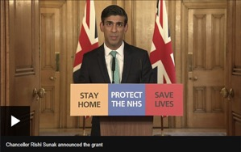
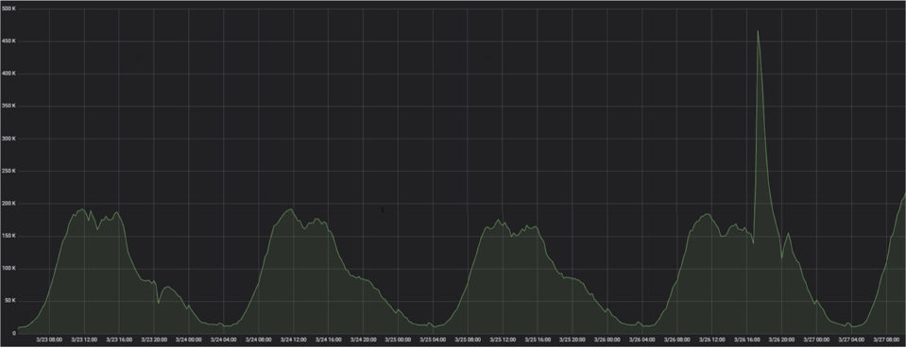
GOVERNMENT ANNOUNCES
FINANCIAL RELIEF SCHEMES
Notes:
BEN The Government responded by announcing an unprecedented financial support package that would eventually see around 25% of the entire UK workforce being supported by public money.
This support had to be accessed somehow… the Chancellor announced in a live television broadcast, that HMRC would provide access by building 4 new digital services, and doing so FAST.
From the time of the broadcast, which is more or less when our teams found out, they were given 20 working days to deliver the first service.
The spike on this chart is from the announcement of the Self Employed Income Support Scheme, before we had built any new services at all, as people logged into their Tax Accounts to calculate themselves what they might be eligible for.
A normal new Digital Service might take 9-12 months to deliver, from inception, through a Discovery phase, building an MVP, an Alpha, Private Beta, before being launched as a Public Beta.
For the Covid services we didn’t have this luxury, there was no user research as such.

Slide 7

COVID-19
SERVICES:
THE CHALLENGE
THE CHALLENGE:
Build 4 new digital services (CJRS, SEISS, SSP, EOHO)
For many millions of users
In just 20 working days
Pump £ Billions into real banks accounts within hours of launch
Whilst working entirely remotely
Notes:
BEN But the challenges went way beyond ludicrous timescales.
We knew we’d have millions of users but no-one could tell us how many
Whatever we built had to be accessible to everyone and had to be capable of paying out billions into bank accounts within hours of launch
It needed to be secure, with checks being conducted before money was paid out.
And again, because of the lockdown, we’d have to do everything entirely remotely.
Four new services - Job Retention Scheme, introduced us to the work Furlough, Self-employed Income Support Scheme, Statutory Sick Pay and Eat Out to Help Out.

Slide 8


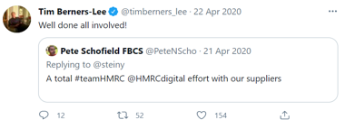
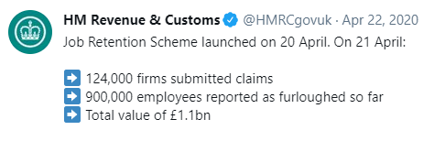
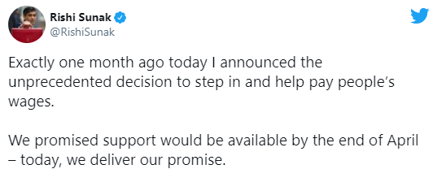
COVID-19 SERVICES SPOILER: WE NAILED IT
Notes:
BEN So how did we do? Well, thankfully, we nailed it.
All the services launched on time, most a week or two ahead of expectations, without any issues and achieved a 94% user satisfaction rating
The job retention scheme paid out >£1 billion in claims on its first day at an average rate of 3 claims per second.
The current value of claims across the 4 schemes is ~£80 Billion
This created some publicity, although perhaps not as much publicity as it would have done if it had all crashed on launch. It was topped by a well-done message we received from Tim Berners-Lee, the founder of the World Wide Web.
Why all the excitement? IT projects in the public sector have reputation for being ~shit~ terrible. At the same time, back in the first lockdown many established national brands in the private sector were struggling to cope with their increased traffic. Major websites crashed, or had to implement some really nasty queuing solutions, just to book a delivery from a supermarket. But our services held up... and the industry wondered how we’d done it.
The answer is that we leveraged a mature digital platform. One that has evolved over the last 7 years and which allows HMRC to rapidly build digital services and then deliver them to the public at hyperscale.

Slide 9


















WHAT IS A PLATFORM AND WHY IS IT USEFUL?
MDTP is a collection of component infrastructure technologies that allows HMRC to serve online content to users
ecs
Notes:
BEN But what exactly is a “Platform” and why it useful?
The Platform aka the Multi-Channel Digital Tax Platform, or MDTP, is a collection of infrastructure technologies that enables HMRC to serve content to users over the internet.
It’s useful because business domains within HMRC can rapidly expose new or existing tax services to the public by funding a small cross-functional team to build a microservice or set of microservices on our platform. The microservice architecture is another talk, but it enables a great deal of what we offer. But that’s not so different from any hosting service.
What makes our platform so useful, is that it removes much of the pain and complexity of getting a digital service in front of a user. We achieve that by building, customising and configuring a suite of common components that are necessary to develop and run high-quality digital products. And we offer these to our tenants for free.
We always struggle to find an image to use on slides that represents MDTP. Indeed once year we ran a competition across HMRC Digital, for someone to draw MDTP.

Slide 10

What does MDTP look like?
Notes:
BEN
This was the winning entry.
As you can see it demonstrates a certain degree of hand eye coordination.
It won by dint of being the only entry.
It doesn’t exactly convey much about the platform itself.

Slide 11
WHAT IS A PLATFORM AND WHY IS IT USEFUL?
MDTP is a collection of component infrastructure technologies that allows HMRC to serve online content to users
ecs
Notes:
BEN So back to the collection of logos.
These logos at the bottom of the slide are some of the tools we employ on the platform. You might notice that the majority are open source, which means they’re often free and we benefit from a global community of engineers, regularly enhancing, extending and securing the products we use.
We have a strong preference for open source tools, which is not the norm in a traditional Government department where there is sometimes still a comfort taken from an expensive licensing arrangement. MDTP and the people that have worked on it, have successfully transitioned a large-scale, public organisation into open-source, on AWS public-cloud and even to coding in the open.

Slide 12
DELIVERING AT SCALE
1200
Microservices
70
Teams
8
Geographic
locations
100
Deployments
a day
2100
People
Notes:
MATT
This talk is also about scale…so how big are we?
Well pretty big. Perhaps a level down from a planet-scale operation like Amazon or Facebook but bigger than many tech organisations. We’re the largest Digital Platform in the UK Government, and due to the number of different services we host, we must be one of the largest platforms in the UK.
We have about 1200 microservices, built by more than 2000 people. And they’re split into 70 teams, across 8 geographic locations. Those teams make about 100 deployments (changes) per day.
All of the teams use agile methods, with deliberately lightweight governance and they’re trusted to make changes themselves, as they see fit. It takes a few seconds to push changes through our infrastructure, so getting products & services in front of users happens fast.
But the platform hasn’t always been this big or busy…. development began with just a single team of engineers, nearly a decade ago… a key part of that story is the Government Digital Service but that’s a talk its own right. Do ask us any questions, if you’re interested, and we’ll do our best to answer them. Link to GDS story, maybe?
Pivotal to the success of the platform, aside from GDS, has been a constant focus on: Culture, Tooling and Practices, with the goal of making it easy to add teams, build services and deliver value quickly.

Slide 13








DELIVERING CUSTOMER-FACING DIGITAL SERVICES
Run at scale
Access advice & guidance
Operate
Build & deploy
Cross-functional Digital Teams:
User researchers,
Interaction designers, Content Designers, Developers, QAs, Business Analysts, et al
Collaborate
Develop
Notes:
MATT Our teams couldn’t have done that without understanding what’s involved in getting a digital service in front of a user, and doing so rapidly, reliably and repeatedly.
We’ve designed the platform around these goals, so a cross-functional team can very quickly come together and make use of our common tooling to design, develop, test and operate a public-facing digital service.
But what does that actually mean in practice? Quite simply, a bunch of developers, user researchers, content designers and product people can form what we call a service team.
Everything you see on the right hand side of the screen, that service team gets for free, right out of the box.
We provide somewhere for the code to live (like Github)
Automated pipelines to get the code built, tested and deployed into production environments, for rapid user feedback
Telemetry tooling to enable a team to monitor its services, with automated dashboards and alerting mechanisms
Collaboration tools to help teams communicate and work effectively, both remotely and in person
All of this is available more or less instantly, with minimal configuration or manual steps required. The result is that the engineers can focus solely on solving the business problem, rather than anything else.

Slide 14

WE HAVE STRONG OPINIONS
SELF-SERVICE +
INFRASTRUCTURE-AS-CODE =
SPEED
Thou shall use Scala with Play
Thou shall only use Mongo (sort of)
Thou shall self-serve
Thou shall not get AWS creds
Notes:
MATT One of the key principles that enables us to work in this way and at this scale, is the concept of an opinionated platform. You might have heard this idea being referred to as a “paved road”, or “the golden path” or simply “guardrails”.
With over 2,000 actors making changes, potentially several times a day, things could get very messy, very quickly. Our answer is to bake some governance into the platform itself..
The basic rules are:
If you build a microservice, it must be written in Scala and it must use the Play Framework.
If your service needs persistence, it must use Mongo
If your user needs to perform a common action like uploading a file, you must use a common platform service to do that
The benefit of this is most obviously that, if you stick to the rails, you can go really, really fast to deliver a new service.
By limiting the technology used on the platform, the platform is simpler to support, and can provide common, reusable components that we know will work for all services.
It also allows people to move between services and indeed services to move to new teams, without worrying about whether our people have the required skills/experience… they should all know Scala.
Furthermore, it prevents waste! Or it’s supposed to anyway. With common components that are mandated, we prevent all 70 teams spending time rolling their own solutions to problems that are already solved. Now, obviously not every team follows the rules all the time but in general we find most teams see the benefit of doing so.
Crucially, the need to care about infrastructure is abstracted away from service producers, so they can focus solely on their apps. They can still observe the infrastructure through tools like Kibana / Grafana but none of the service teams have access to AWS accounts themselves.
Our opinions can and do change, according to user needs and demand for more features. If a single team wants access to the latest AWS feature, then they’ll probably struggle to get traction, but if ten teams start demonstrating a justifiable need for something, we’ll work to provide it in a repeatable way, enabling self service.
The self service part is critical. A service can be created, developed and deployed on our Platform, without any direct involvement from the Platform teams at all.

Slide 15
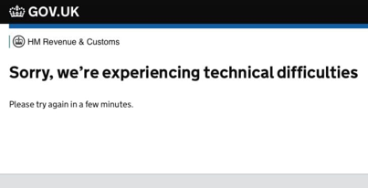

IT WASN’T ALL PLANE SAILING
How did we plan for and cope with the traffic?
What about our legacy or 3rd party dependencies?
What about fraud?!
Notes:
BEN
We’ve talked a lot about the Platform and why it’s good, but delivering during the pandemic wasn’t all plane sailing. The UK economy desperately needed this to work and we desperately wanted to avoid any users seeing messages like the one at the top of this slide.
The first part of our problem was precedent. To have lived through the last global pandemic, you’d have to be 102 years old. And although tax was definitely a thing back in 1918, it was very much a paper based system.
For our annual Key Business Events, we tend to have years of data, so we can forecast to hourly granularity how many people we can expect to use any given service at one time.
For these new services we lacked data, we lacked traffic profiles and we lacked models. All we had were ballpark estimates of the eligible population and a hunch that offering people thousands of pounds when they had no other income would be popular. The estimates produced big, scary numbers.
We could performance test our own services and scale them, but where we had dependencies with 3rd parties who were not able to scale, we had to do a lot of work to make those API calls asynchronous wherever possible.
We also, quite deliberately, prioritised getting money to people who needed it, over preventing fraud. Now, that doesn’t mean that we’d make it easy for fraudsters but it does mean that we were racing to complete the development of our new counter-fraud measures, right up until launch.

Slide 16
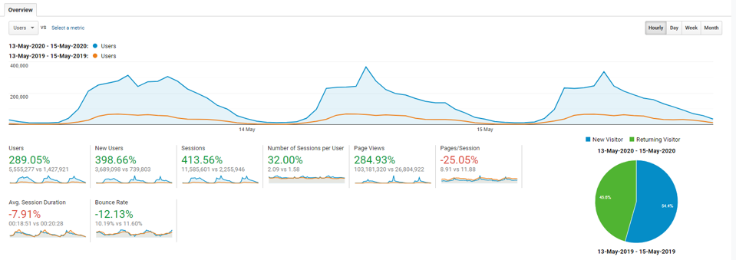
SCALING MDTP
Notes:
BEN So how do did we tackle the problem of scale? In essence by, making everything really big.
The huge advantage of having a platform composed of immutable infrastructure defined as code, is that even the parts of the platform that need to be manually scaled, can easily be.
Covid-19 teams were working hand in glove with our Platform teams. Between us, we created worst-case traffic profiles, which were based on overall eligibility for the schemes, combined with observed behaviour; like traffic spikes from previous business events, and even spikes we’d seen after recent TV announcements. Certain services are already victim to what we term the Martin Lewis effect, because of what happens when everyone’s favourite consumer rights champion talks about a taxable benefit on TV.
Although we try to ensure everything is self service, the Platform needed to be responsive to these new requirements. To take a few of these as examples, the load testing required was at a level that a single instance of Gatling was not able to provide, so our Build and Deploy team added features to enable load testing in parallel. This increase load then err, broke our logging pipeline, so Telemetry then needed to be scaled up, in both Staging and Production to handle the increase in logs being generated. This was DevOps in action.

Slide 17
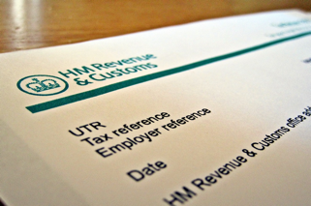
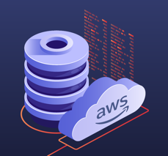
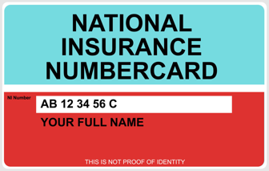
COPING WITH LEGACY
Minimising dependencies on legacy HMRC systems
Notes:
BEN But that was just the beginning of the scaling problem.
MDTP is relatively new and shiny, certainly in UK Government terms. It was chosen to deliver the Covid19 Services because it offered the best chance of meeting the ambitious development deadlines and then scaling to support the tsunami of expected traffic.
However, as much as we believe in the power of a hyperscale cloud provider, wider HMRC is still much more conservative about where and how it holds citizen data. And that means that information about people and their taxes doesn’t live for long on MDTP. HMRC does hold a great deal of confidential information about every company and taxpayer in the UK. We protect data on MDTP by ensuring that data can only be accessed by authorised microservices, but most the systems of record exist downstream of MDTP in the HMRC Corporate tier.

Slide 18

THE LEGACY
HMRC ESTATE
Image shown not actual HMRC operated Datacenter. As far as I know.
Notes:
BEN It’s mostly stored on a mixture of mainframes and old physical hardware, which is impossible to scale to cope with the level of traffic that we expected.
So before a line of code was written, we realised we’d need to remove any synchronous reliance on these datastores and host everything on MDTP.
We achieved that in collaboration with the service teams. The user journeys were cleverly designed, so that we could gather some information ahead of launch and avoid unnecessary load at peak times from ineligible customers. We then migrated the core eligibility and financial claim data from the legacy datacentres, into temporary stores on MDTP, using a combination of Amazon S3, MongoDB and some fairly crude data transfer methods - manually copying things up to S3 from a secure laptop.

Slide 19
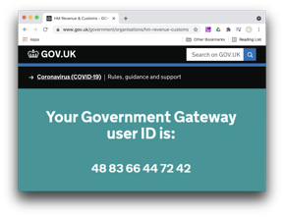
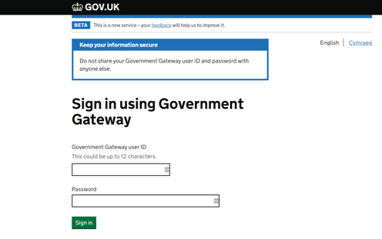
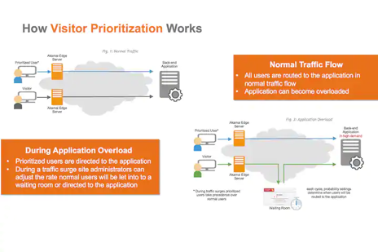
COPING WITH 3RD PARTIES
Notes:
BEN Despite all this, we still had some nervous moments, when things could have gone wrong. There were late nights. There were early mornings. There were a lot of tired developers. With one of the services, there was also an enormous peak of traffic at midday that HMRC were entirely responsible for generating ourselves. MDTP was perfectly able to handle this traffic but the third party systems on which it relies, were not.
These dependencies would constrain parts of the Covid-19 service to something like 30% of what the Platform itself could handle. We moved these to be asynchronous calls where possible, but logging in had to be part of the user journey.

Slide 20
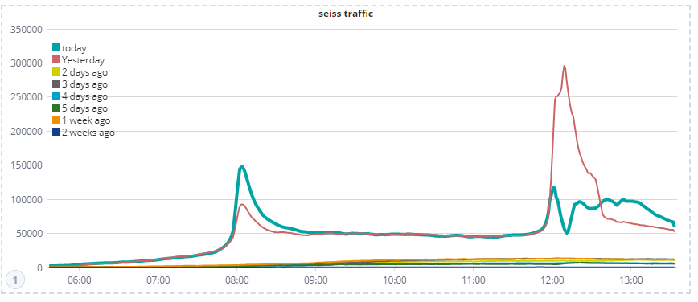
SQUEAKY BUM TIME
NEVER GIVE HALF A MILLION PEOPLE A SPECIFIC TIME WHEN THEY CAN CLAIM £7,500.
Notes:
BEN The reason for the peak is that HMRC had decided to stagger the traffic, by notifying people of a specific day on which they could claim. This was in itself entirely sensible. However, splitting that traffic in two by giving people a time from which they could claim, either 8am or 12pm was entirely self-defeating.
It turns out that 8am is too early for a lot of people to log on to an HMRC website, even if it’s to claim money; but midday is ideal, and so hundreds of thousands set reminders on their phones and tried to log in at the same time.
Government Gateway is used for logging in, and we knew it could cope with ~200 logins per second before it started to creak. We didn’t have time to scale that any higher due to the complexity of the interactions between the two platforms.
Given that we anticipated many more than 200 logins per second, we needed a break-glass and decided on using Akamai Visitor Prioritisation. This is a crude, manual tool, that offers the ability to throttle traffic by holding users in a “waiting room” and allowing a certain percentage through every 30 seconds. This needed to be configured in advance, and we’re really glad that we did so.
The peak of our peakiest peak saw well over 1,000 login requests per second. A swarm of about 50 engineers from across both platforms and the service teams monitored the event live and worked together over Google Hangouts to manage the traffic, trying to estimate the percentage to allow through, although we had very limited visibility of the numbers attempting to login. Despite initially having close to 100,000 users in the waiting room, we were able to let them into the service relatively quickly, so much so, that we didn’t receive a single complaint.

Slide 21
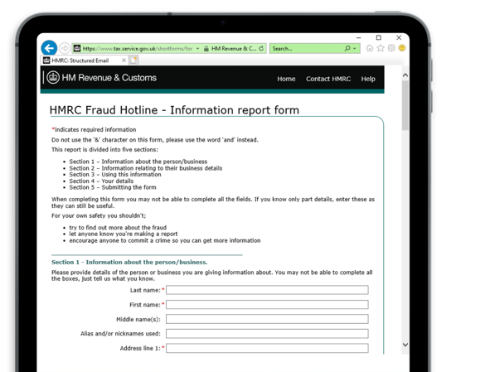

FIGHTING FRAUD
A balancing act between:
Ease of use
Fairness
Security
Time
Notes:
MATT We mentioned earlier that our priority was getting money into the hands of people who really needed it.
But HMRC was also acutely aware that this would be the largest giveaway of public money in living memory, and therefore, an irresistible target for fraud.
Whilst the service teams prioritised building functionality to power the new user journeys, there were teams across HMRC that were busy beefing-up, or building entirely new anti-fraud measures. These varied from plugging into 3rd party systems that check for dodgy bank accounts, to extending HMRC’s entire internal fraud-risking system, which was a massive task.
But…with just 4 days left before public launch, the integration between the first Covid-19 service and the new internal fraud-risking system, which is hosted on an entirely different platform, still hadn’t been built. What’s more, the service team didn’t have the capacity to build it.
Instead, one of our platform teams picked up the batton and found a way to get the data flowing between these two services. Frankly, this involved breaking most of the rules which we usually insist on. There were two microservices sharing a single database and a totally hacked means of the second microservice authenticating against it. However the solution also involved quickly learning some really cool stuff… like Amazon S3 bucket replication across AWS accounts, which we ended up using to solve a whole bunch of problems elsewhere.
The result was that the fraud risking capability went live together with the service, which I can tell you personally, seemed an unlikely outcome at 4:30am on the morning of the launch. How much fraud did it catch? Well the truth is that we don’t know yet. Officially HMRC has assumed for planning purposes that between 5%-10% of all claims would be either fraudulent or incorrect. What we’ve seen is around 70,000 cases marked for investigation so far but proving the fraud takes time. It’ll be interesting to see what comes out of that.

Slide 22

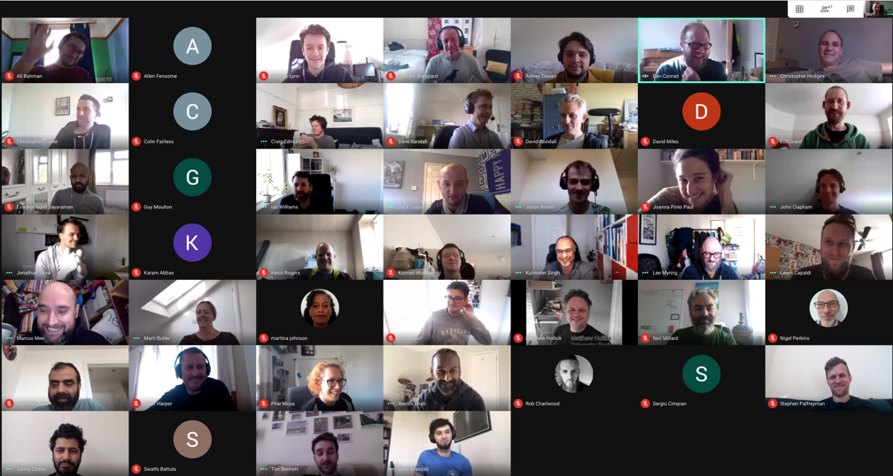

THE NEW NORMAL?
Notes:
MATT Stories like these were abundant. Everywhere you looked there was innovation, improvisation and a Herculean people effort.
It didn’t stop with the initial service launch. All of these “temporary” services continue to be developed today, as the teams iterate and add features, which they didn’t have time to release last year. There are even more services being built as the Government continues to announce further initiatives to help the public… and they trust HMRC to be able to get them out on time.
The number of services in our production environment has grown by 30% in just the last year.
In many ways Covid-19 has forced us to re-draw what we thought was possible. It’s become the new normal… but that’s not entirely a good thing.

Slide 23

WHAT WE LEARNT
There is such a thing as too fast
Be careful of setting unhelpful precedents, even when saving the world!
People need sleep
Notes:
MATT We learnt that:
1) It’s not good to integrate a country-scale fraud risking system in 4 days
2) Be careful of unhelpful precedents:
It’s not advisable to compromise your fundamental design standards to get a product shipped
It’s almost always best to avoid doing anything manually, particularly large scale dumps of citizen data
3) Finally, it’s never good to ask an engineer to work more days in April than there are days in April.
We have to remember that what was achieved was done so under incredible pressure, by willing and determined people, with the knowledge that they were helping their families, friends and neighbours to, quite literally, survive.
Now it’s true that there wasn’t a lot going on socially at the time and anyone with children would have killed for an excuse to get out of home-schooling but that doesn’t make it ok... At points we had to tell engineers to stop working and go to sleep.
The point is that working as our teams did in 2020 isn’t sustainable.
This is a message that we need to keep reinforcing with our leadership community and with other government departments, who are, understandably interested in learning how we got things done so quickly.
The legacy of Covid-19 for our teams, alongside the pride and sense of achievement at doing an incredible job, is a collective burn-out and a fatigue with being 100% remote.
We’re now focused on how we make our ways of working sustainable in whatever turns out to be the new normal, with a commitment to maintaining the flexibility that our people want but reviving the camaraderie and human contact that we took for granted, when we were together every day.

Slide 24
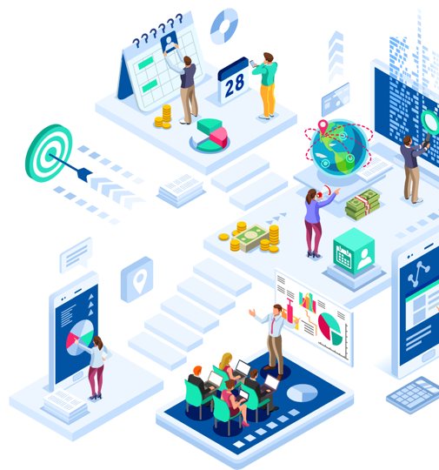



JUST ONE MORE THING...
We replatformed at the same time
Notes:
BEN HMRC have migrated the platform away from our homegrown legacy deployment tooling to run on AWS Elastic Container Service. This project was delivered by utilising a Tiger Team made up of engineers from the different platform teams who develop the Tax Platform, drawing on the expertise available to us while ensuring other important work continued to be delivered. The result is a modern platform which is simpler to operate and will scale elastically in response to demand. I’m proud to say we even won an Industry Award for it, and hugely proud that we completed it, with zero downtime, as we hosted hundreds of important services.
https://docs.google.com/document/d/1A_n1uqc-JXiBEBV-KUDtD41NcGsErFBc-SJD451kZQU/edit

Slide 25

Build more trust
Increase adoption
Help the rest of HMRC and UK Government to transform its relationship with technology and making change
Notes:
BEN We believe we have this amazing platform, and we have shown that it can enable services to be build and deployed at breakneck speed, and scale to cope with more traffic than a Government website should ever expect to see. We believe we are more secure than many of the legacy systems of record and we hope that we are able to build on the reputation we have grown over the last seven years.
Digital sections of departments were set up 7 or 8 years ago, and although they’ve succeeded in transforming the experience of using Government Digital Services, they have mostly operated in a silo, and failed to deliver the revolution in how technology is delivered across government. I hope that can change.
As we look to possibly host additional services we will always need to keep the opinions we hold under review. There is a balance between the consistency that enables rapid delivery and stifling innovation by restricting people in the technology they would like to use.
And one day soon we might even meet up again in person.

Slide 26
THANK YOU
FURTHER READING:
Digital Platforms Playbook
More Context on HMRC’s digital journey
Expert clinic on the subject of Continuous Delivery
An in-depth look at how HMRC added bank reputation scrutiny and built services quickly during the pandemic.
Notes:
BEN And that’s that... Our story of building some digital stuff to save an economy during a pandemic..
Thank you so much for listening. It really is a privilege to have shared this with you today. Hopefully none of us ever need to build anything to fight a pandemic again but if you are interested in finding out more about any of the things we’ve touched on, we’ll happily answer questions and share some links to things we’ve published.
Thank you.

Slide 27
THANK YOU
FURTHER READING:
Digital Platforms Playbook
More Context on HMRC’s digital journey
Expert clinic on the subject of Continuous Delivery
An in-depth look at how HMRC added bank reputation scrutiny and built services quickly during the pandemic.

